Slide 1


PROFESSIONAL READINESS FOR INNOVATION , EMPLOYABILITY AND ENTREPRENEURSHIP
SIGNMATE-Sign Language detection system
ARVINDBALAJE D(210701030)
AJAY Y(210701020)

Slide 2
PROBLEM STATEMENT
Develop an interactive game-based education app integrating points and leaderboard, ensuring inclusivity for disabled students aiming for improved learning and confidence.
Specific Focus: Detect American Sign Language (ASL) for children below 5 years old using computer vision and machine learning techniques.
Challenges Addressed:
Lack of engaging educational tools for disabled children, particularly those with hearing impairments.
Need for inclusive learning environments that foster confidence and participation.

Slide 3
INTRODUCTION
SignMate Overview: SignMate is an innovative educational application designed to teach young children American Sign Language (ASL) through interactive games.
Key Features:
Utilizes machine learning models to accurately detect and interpret ASL.
Engages children through a point-based system and leaderboards to motivate learning.
Ensures accessibility and inclusivity for disabled children.

Slide 4
EXISTING SYSTEM
Current Solutions:
Traditional learning methods (books, flashcards).
Basic sign language apps without gamification or interactivity.
Disadvantages:
Limited engagement and motivation for young learners.
Lack of inclusivity features for children with disabilities.
Insufficient accuracy and interactivity in existing sign language detection apps.

Slide 5
PROPOSED SYSTEM
Combines ASL detection with interactive gaming elements.
Utilizes computer vision and deep learning for accurate ASL recognition.
Points and leaderboards to enhance motivation.
Interactive feedback to ensure children remain engaged and interested.
Designed with features to support disabled students, ensuring equal learning opportunities.

Slide 6
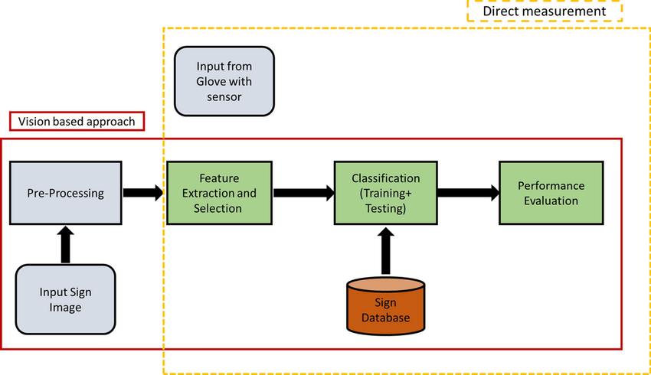


ARCHITECTURE DIAGRAM

Slide 7




DATASET

Slide 8


OUTPUTS

Slide 9
CONCLUSION
Thus, SignMate effectively combines ASL detection with interactive gaming to provide an inclusive and engaging educational experience.
Emphasizes improved learning and confidence among young children, particularly those with disabilities.
Impact:
Potential to revolutionize educational tools for disabled students.
Promotes inclusivity and equal learning opportunities.

Slide 10
FUTURE ENHANCEMENTS
Expansion of Sign Language Detection:
Inclusion of more complex ASL signs and phrases.
Support for additional sign languages.
Advanced Gamification:
More interactive and varied game scenarios.
Enhanced feedback mechanisms.
Inclusivity Features:
Additional accessibility features for children with other disabilities.
Integration with speech and language therapy tools.
Technology Upgrades:
Use of more advanced machine learning models for higher accuracy.
Incorporation of augmented reality (AR) for a more immersive learning experience.

Slide 11
Thank You

